Slide 1
Clustering Longitudinal Data for Disease Modeling
Nick Henscheid, Quantitative Medicine Scientist
U.A. Applied Math Hackathon Feb 2025
Notes:
Pitch Deck - General

Slide 2
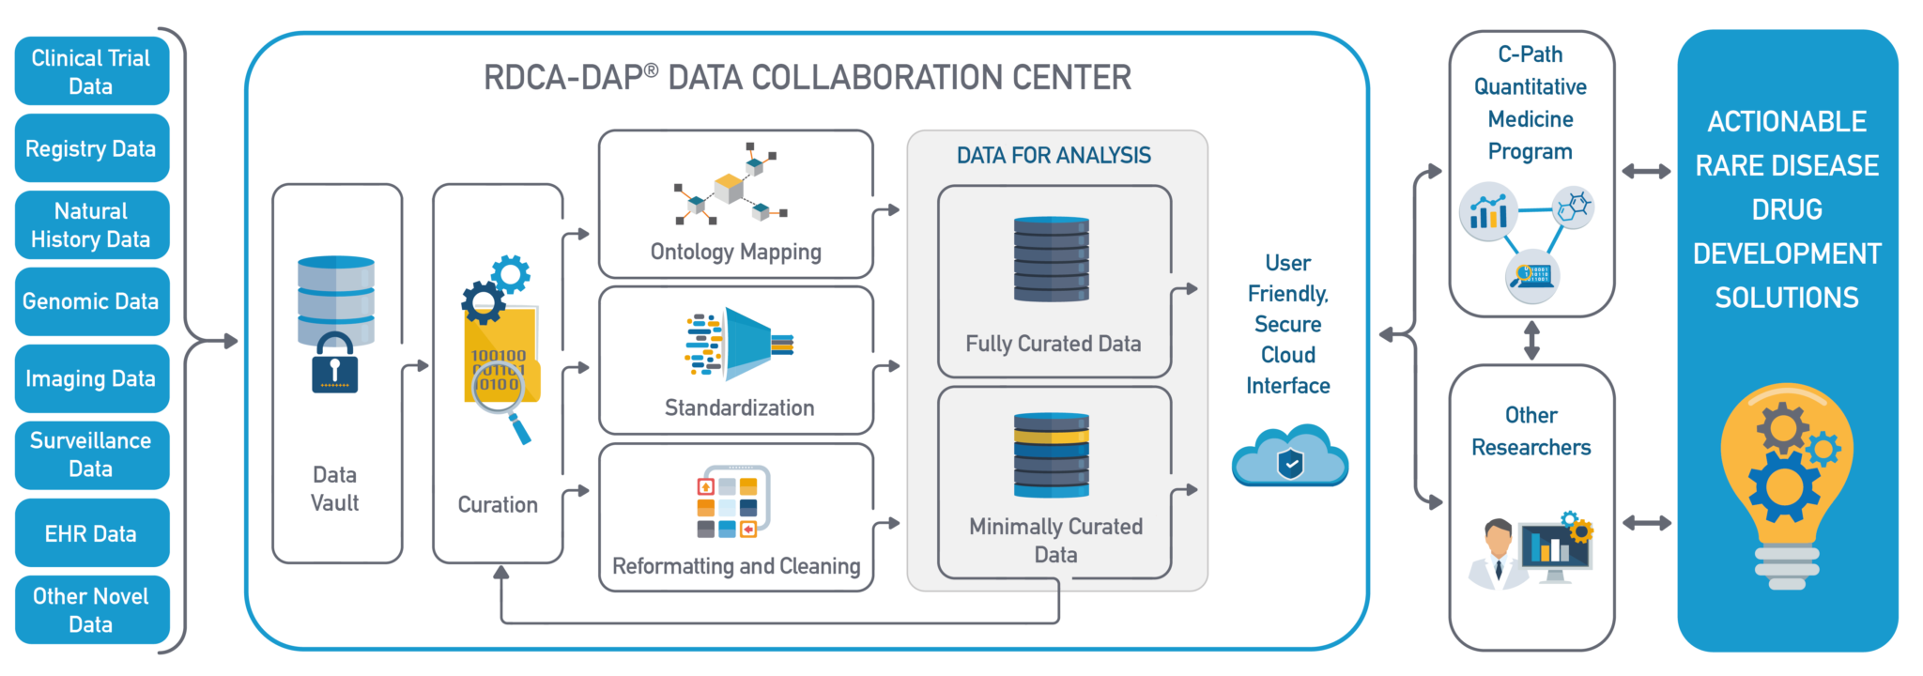
Quantitative Tool Pipeline

Slide 3
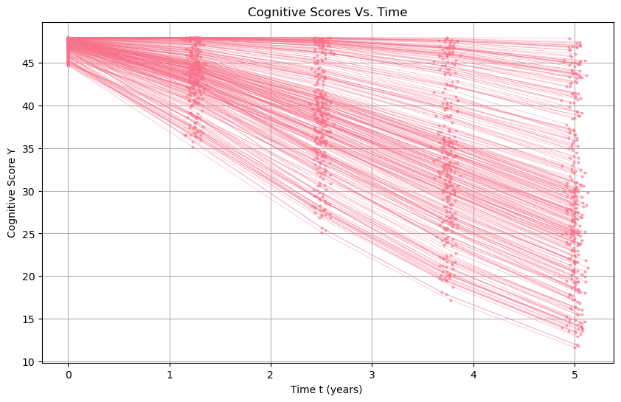
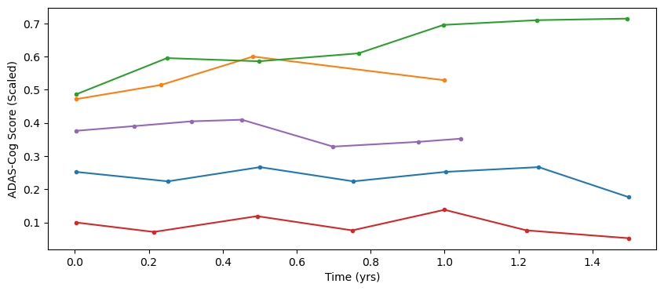
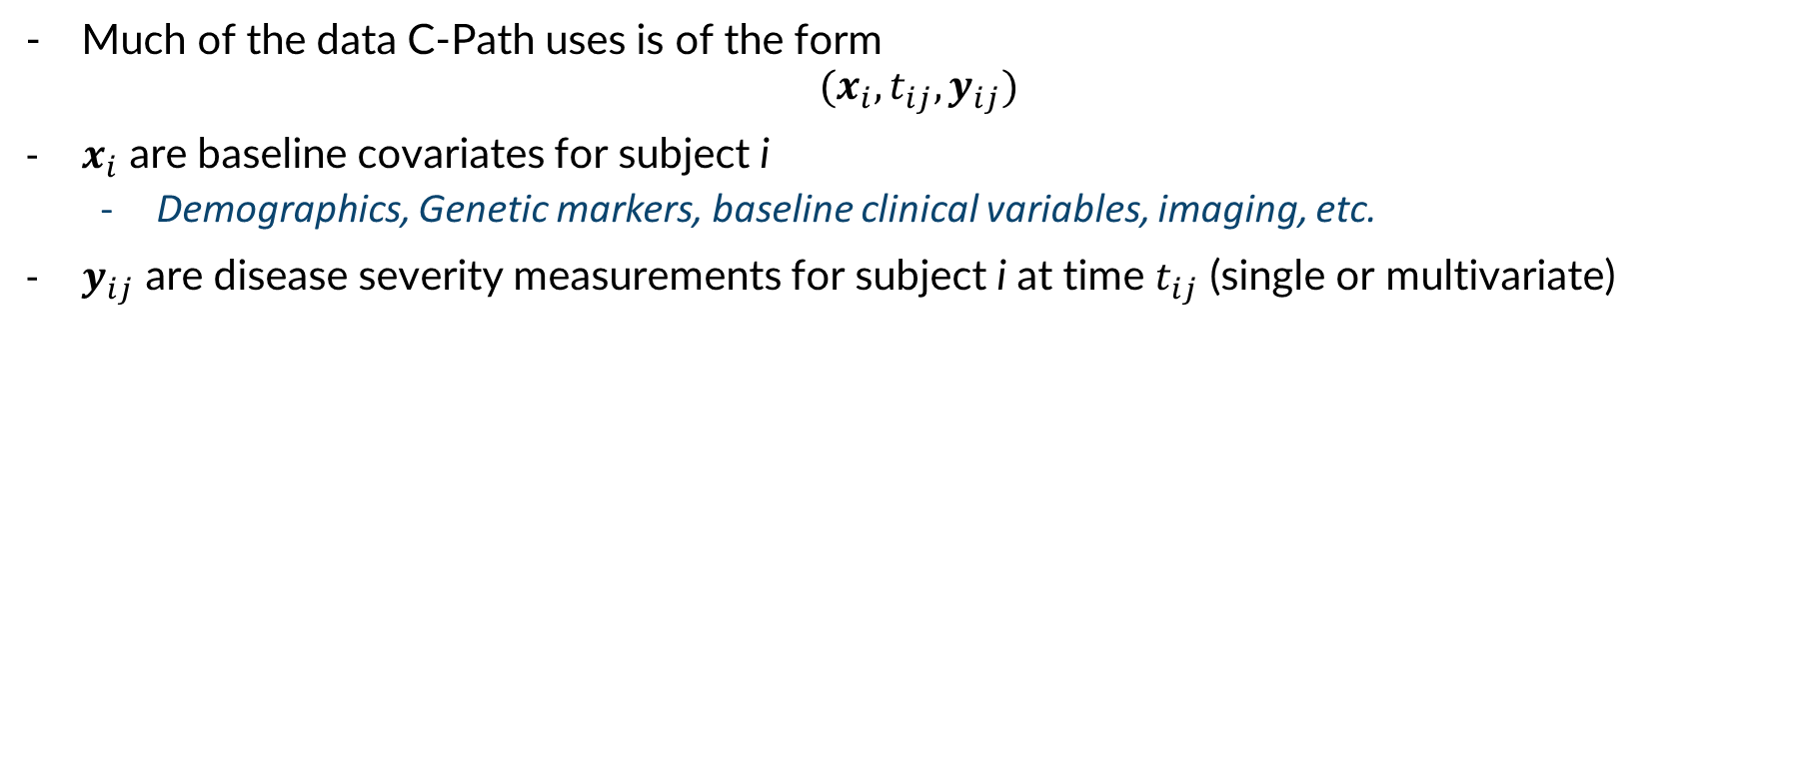
Longitudinal Data
Much of the data C-Path uses is of the form
$$(x_{i},t_{ij}, y_{ij})$$
$x_{i}$ are baseline covariates for subject i
Demographics, Genetic markers, baseline clinical variables, imaging, etc.
$y_{ij}$ are disease severity measurements for subject i at time $t_{ij}$ (single or multivariate)

Slide 4
Discussion Questions
What are some approaches to modeling this kind of data?
What kind of inferences might we want to make with a model of our data?
Notes:
- NLME, ML methods, functional methods (GP, splines, etc) . Trial simulation, biomarkers of disease progression, endpoint assessment.

Slide 5
Heterogeneity
Heterogeneity is a basic fact of life in biomedical data analysis
It comes in several forms:
Inter-individual variability (different subjects behave differently)
Intra-individual variability (the same subject may deviate from expected)
Residual variability (meas. noise & model error)
Quantifying/managing heterogeneity is the key task in Quantitative Medicine!
How can mathematical modeling help?
Disease
Disease progression
Time-to-event
Drug
PK/PD, PBPK, ER
QSP
Trial
CTE, CTS
Novel designs (platform, adaptive, etc.)
Biomarkers, COAs, etc.
Precision dosing

Slide 6
Discussion Questions
- What are some approaches to quantifying heterogeneity in longitudinal data?
- Are there forms of heterogeneity that might be more impactful in clinical trial design?

Slide 7
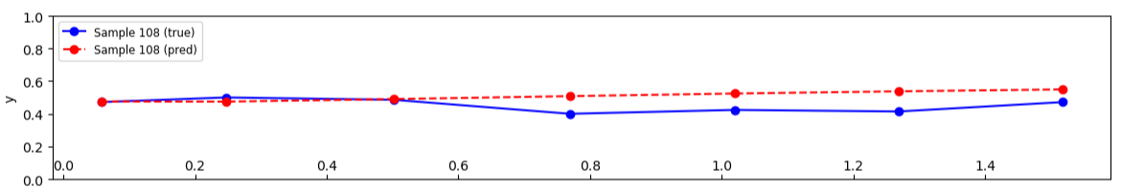
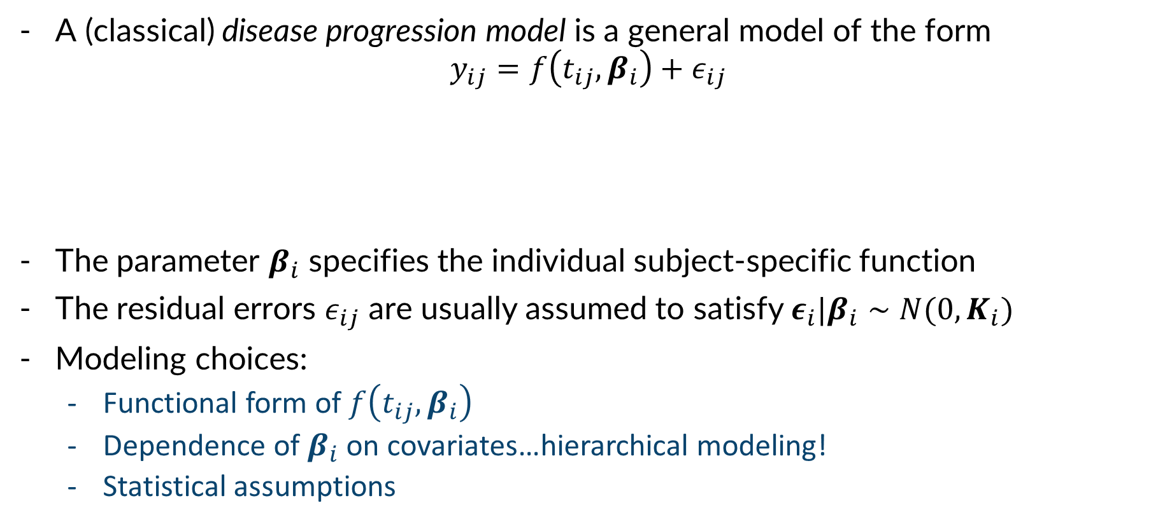
Disease Progression Models
A (classical) disease progression model is a general model of the form
$$y_{ij}=f\left(t_{ij},β_{i}\right)+ε_{ij}$$
The parameter $β_{i}$ specifies the individual subject-specific function
The residual errors $ε_{ij}$ are usually assumed to satisfy $ε_{i}|β_{i}∼N(0,K_{i})$
Modeling choices:
Functional form of $f\left(t_{ij},β_{i}\right)$
Dependence of $β_{i}$ on covariates…hierarchical modeling!
Statistical assumptions

Slide 8
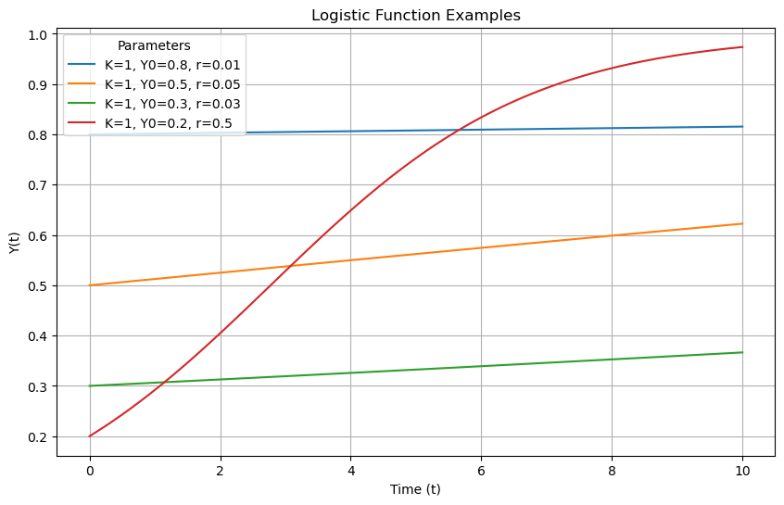
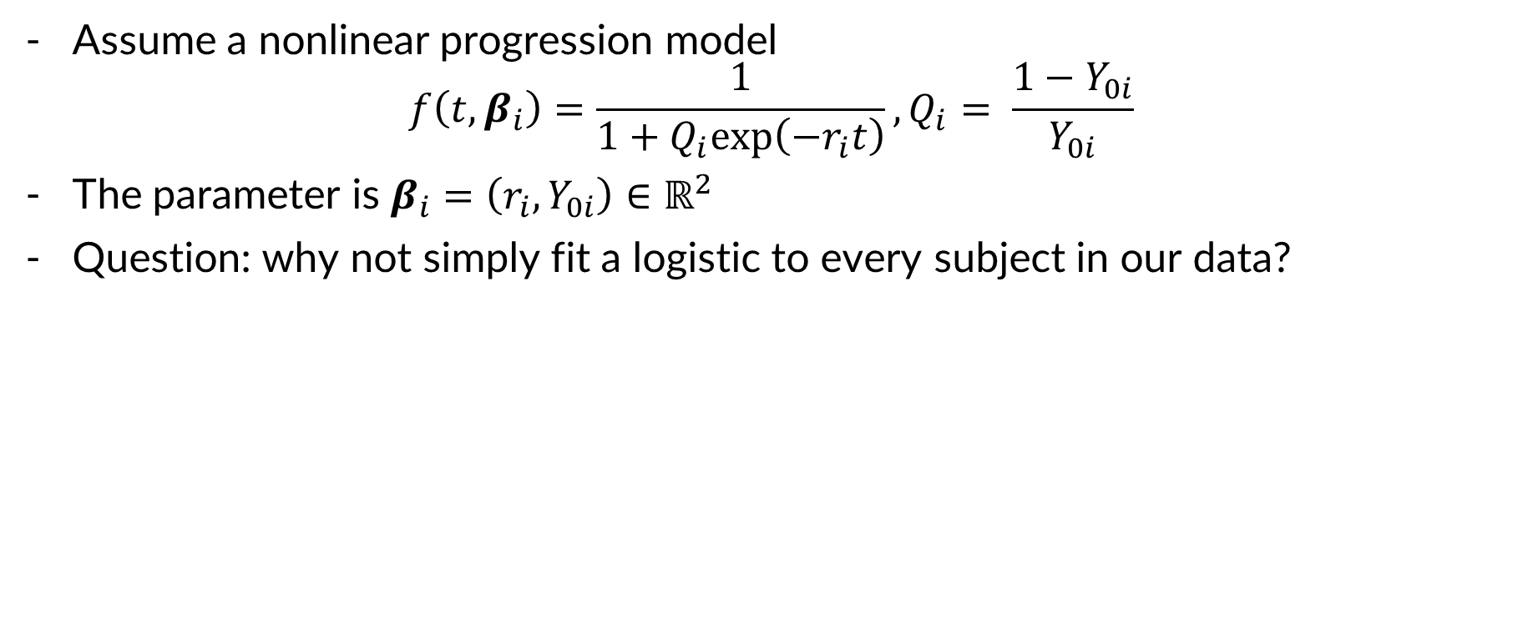
Basic Example: Logistic
Assume a nonlinear progression model
$$f\left(t,β_{i}\right)=\frac{1}{1+Q_{i}exp\left(−r_{i}t\right)}, Q_{i}= \frac{1−Y_{0i}}{Y_{0i}}$$
The parameter is $β_{i}=\left(r_{i}, Y_{0i}\right)∈ℝ^{2}$
Question: why not simply fit a logistic to every subject in our data?
Notes:
Answer to question: individual estimates can be noisy, insufficient data. Not “borrowing” information from the population to improve individual estimates -> bad inference approach

Slide 9
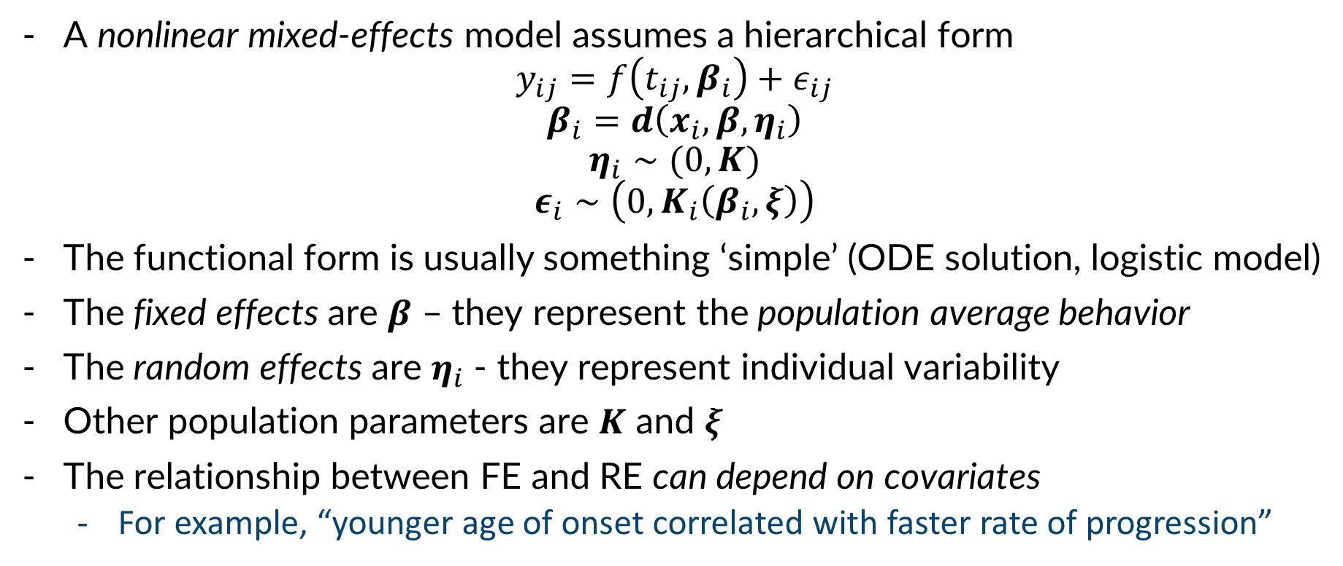
Classical NLME Models
A nonlinear mixed-effects model assumes a hierarchical form
$$y_{ij}=f\left(t_{ij},β_{i}\right)+ε_{ij}$$
$$β_{i}=d\left(x_{i},β,η_{i}\right)$$
$$η_{i}∼(0,K)$$
$$ε_{i}∼\left(0,K_{i}\left(β_{i},ξ\right)\right)$$
The functional form is usually something ‘simple’ (ODE solution, logistic model)
The fixed effects are $β$ – they represent the population average behavior
The random effects are $η_{i}$ - they represent individual variability
Other population parameters are $K$ and $ξ$
The relationship between FE and RE can depend on covariates
For example, “younger age of onset correlated with faster rate of progression”
Notes:
Point out the fact that beta_i are not fit during typical point estimation!

Slide 10
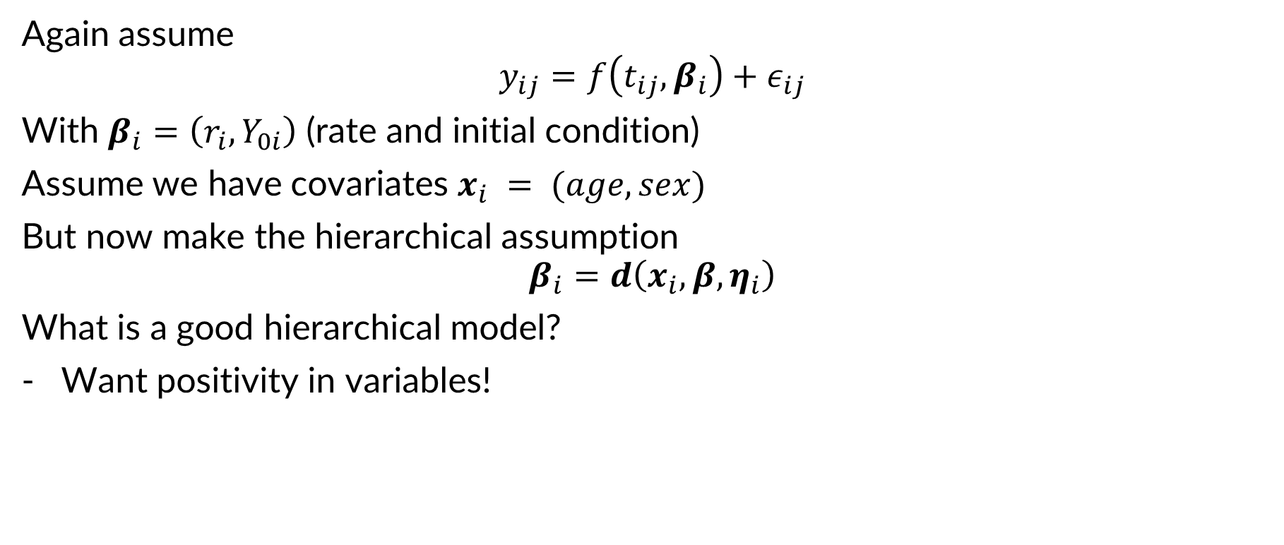
Example: Logistic, cont’d
Again assume
$$y_{ij}=f\left(t_{ij},β_{i}\right)+ε_{ij}$$
With $β_{i}=\left(r_{i},Y_{0i}\right)$ (rate and initial condition)
Assume we have covariates $x_{i} = (age,sex)$
But now make the hierarchical assumption
$$β_{i}=d\left(x_{i},β,η_{i}\right)$$
What is a good hierarchical model?
Want positivity in variables!
Notes:
Log-linear model for covariate effects i.e. log(beta_i) = log(beta) + sum_k theta_k x_k + eta_i

Slide 11
Discussion Questions
Suppose we fit our hierarchical model, but we see systematic errors – some subjects seem to consistently deviate from their curve
What might cause this?
Notes:
Bad model, latent cluster!

Slide 12
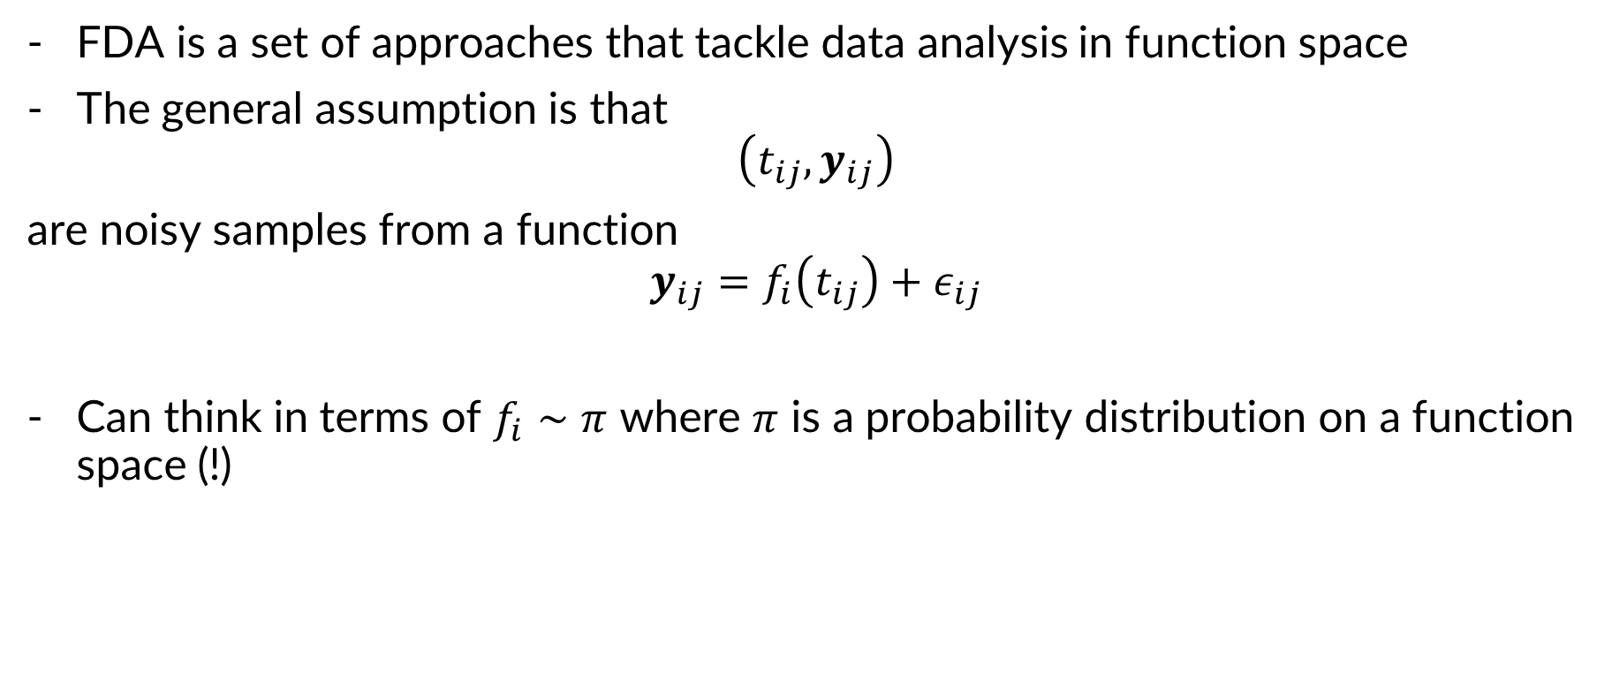
Functional Data Analysis
FDA is a set of approaches that tackle data analysis in function space
The general assumption is that
$$\left(t_{ij}, y_{ij}\right)$$
are noisy samples from a function
$$y_{ij}=f_{i}\left(t_{ij}\right)+ε_{ij}$$
Can think in terms of $f_{i}∼π$ where $π$ is a probability distribution on a function space (!)

Slide 13
Clustering Longitudinal Data: Approaches
Fit functional model to each trajectory -> ‘latent representation/encoding/embedding’
Functional model can be ‘biologically inspired’ or simply a basis expansion (splines, Fourier, etc.)
Cluster the ‘embedded’ vectors using e.g. k means, hierarchical clustering, spectral clustering, etc.
More sophisticated: latent cluster mixed effects models…

Slide 14
Problem Repo
https://github.com/nhenscheid/uahackathon2025
nhenscheid@c-path.org
All data, info, suggested problems available at the above link.
Have fun!

Slide 15
Extra Slides

Slide 16
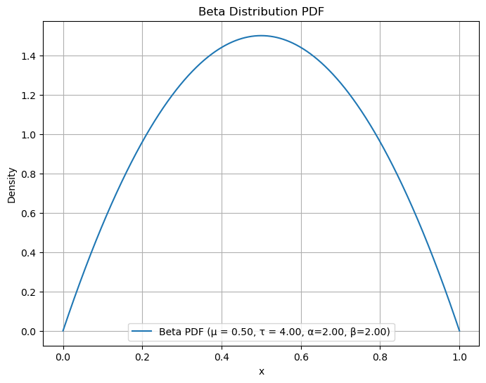
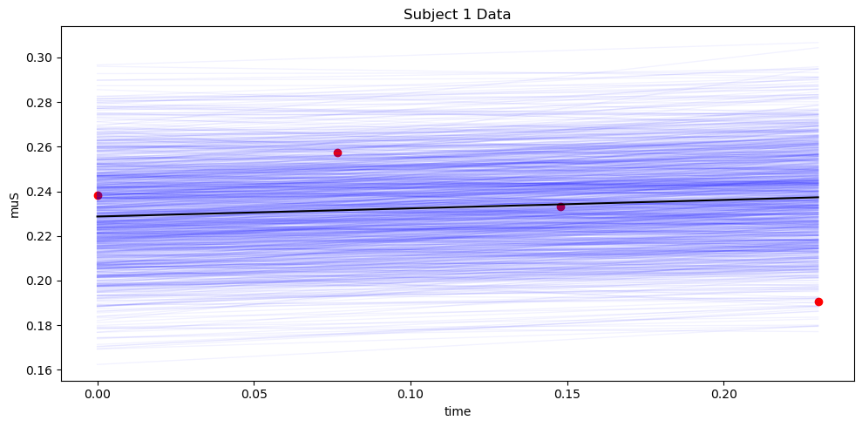
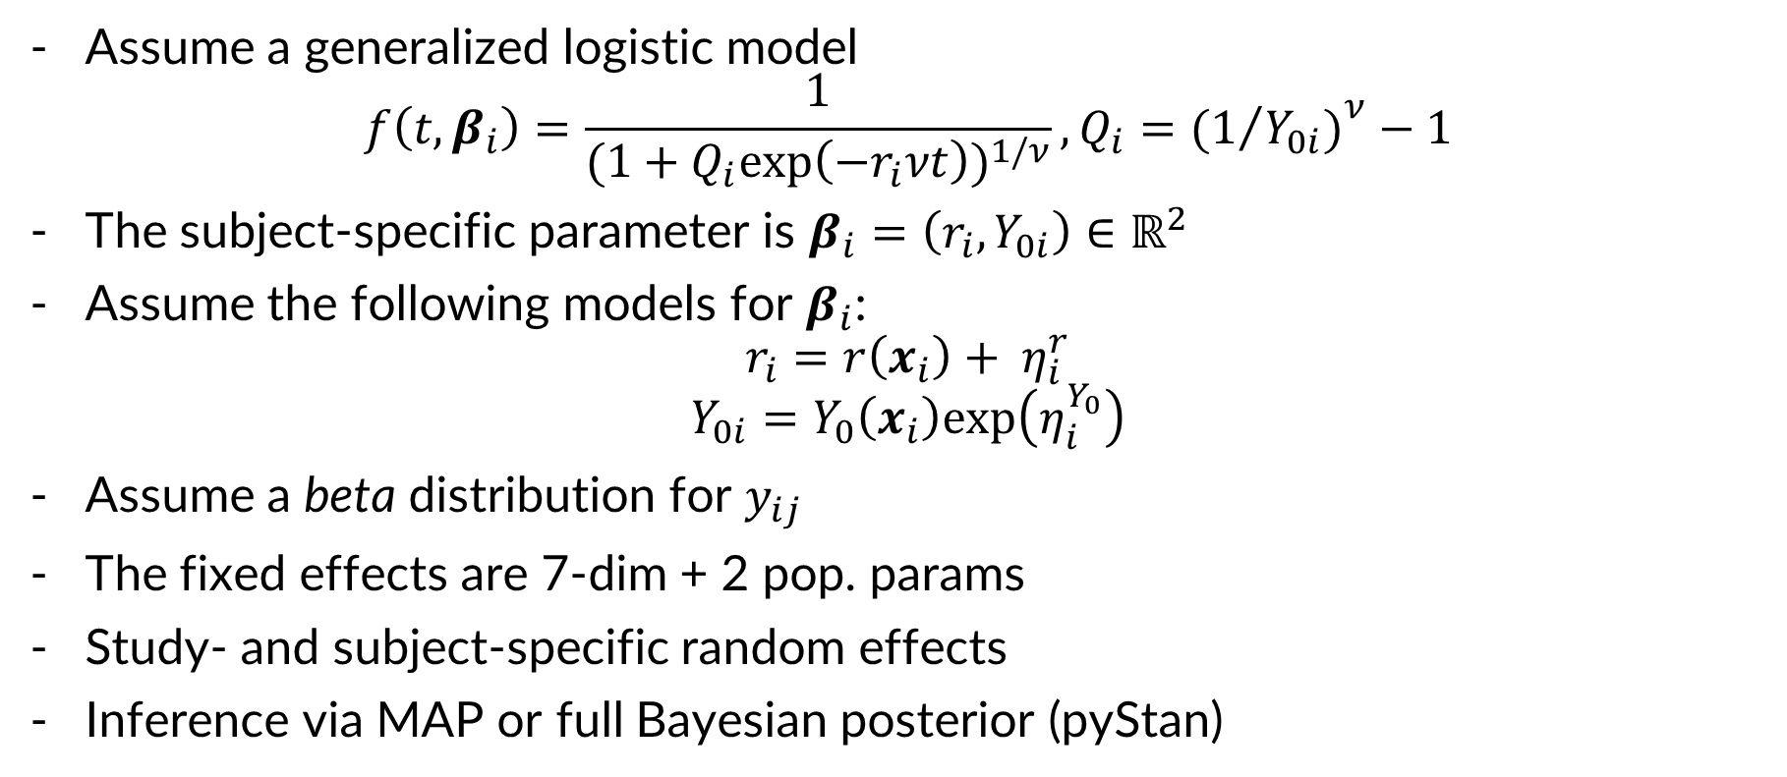
Example: Conrado 2014 AD Model
Assume a generalized logistic model
$$f\left(t,β_{i}\right)=\frac{1}{{(1+Q_{i}exp\left(−r_{i}νt\right))}^{1/ν}},Q_{i}={{(1}/{Y_{0i})}}^{ν}−1$$
The subject-specific parameter is $β_{i}=\left(r_{i}, Y_{0i}\right)∈ℝ^{2}$
Assume the following models for $β_{i}$:
$$r_{i}=r\left(x_{i}\right)+ η_{i}^{r}$$
$$Y_{0i}=Y_{0}\left(x_{i}\right)exp\left(η_{i}^{Y_{0}}\right)$$
Assume a beta distribution for $y_{ij}$
The fixed effects are 7-dim + 2 pop. params
Study- and subject-specific random effects
Inference via MAP or full Bayesian posterior (pyStan)

Slide 17
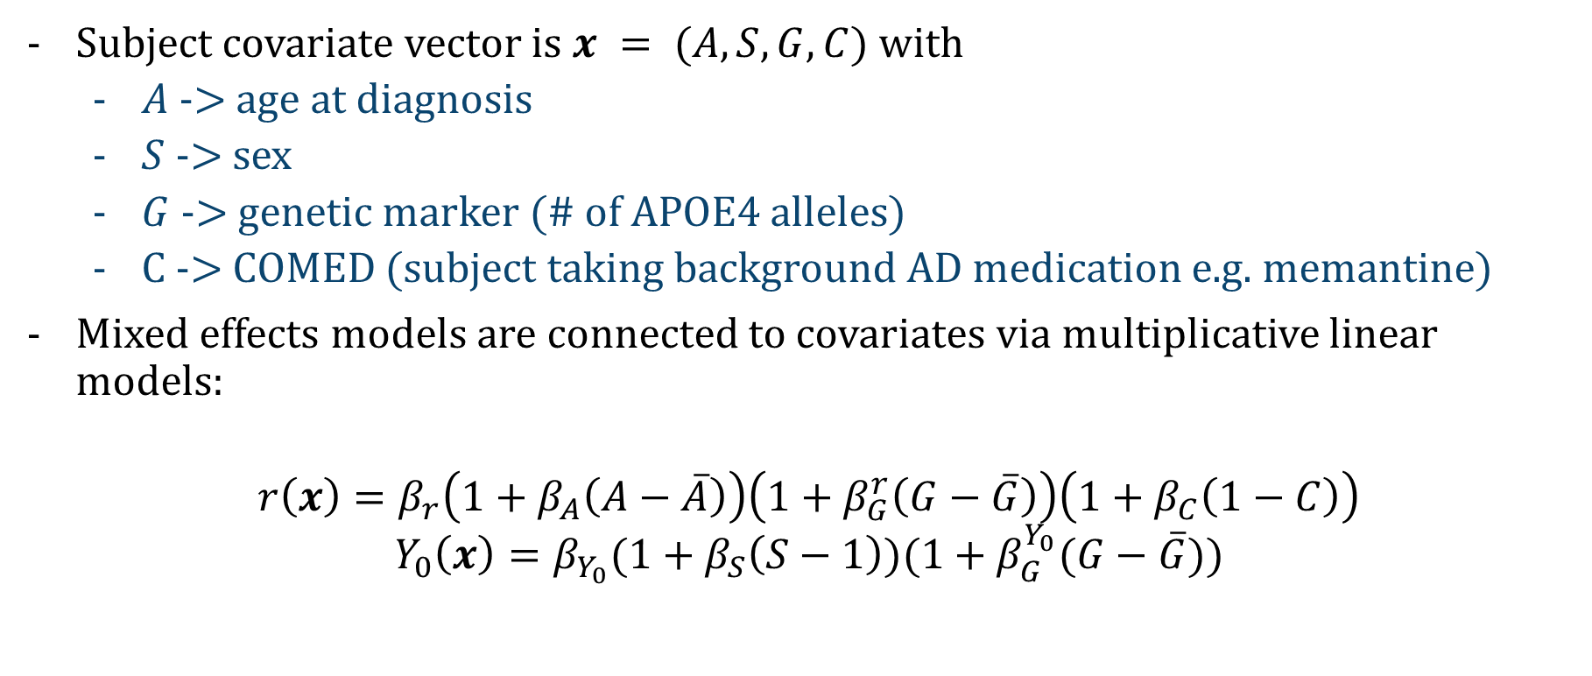
Covariate Models in Conrado 2014
Subject covariate vector is $x = (A,S,G,C)$ with
$A$ -> age at diagnosis
$S$ -> sex
$G$ -> genetic marker (# of APOE4 alleles)
C -> COMED (subject taking background AD medication e.g. memantine)
Mixed effects models are connected to covariates via multiplicative linear models:
$${r\left(x\right)=β}_{r}\left(1+β_{A}\left(A−\overline{A}\right)\right)\left(1+β_{G}^{r}\left(G−\overline{G}\right)\right)\left(1+β_{C}\left(1−C\right)\right)$$
$${Y_{0}\left(x\right)=β}_{Y_{0}}(1+β_{S}\left(S−1\right))(1+β_{G}^{Y_{0}}(G−\overline{G}))$$

Slide 18
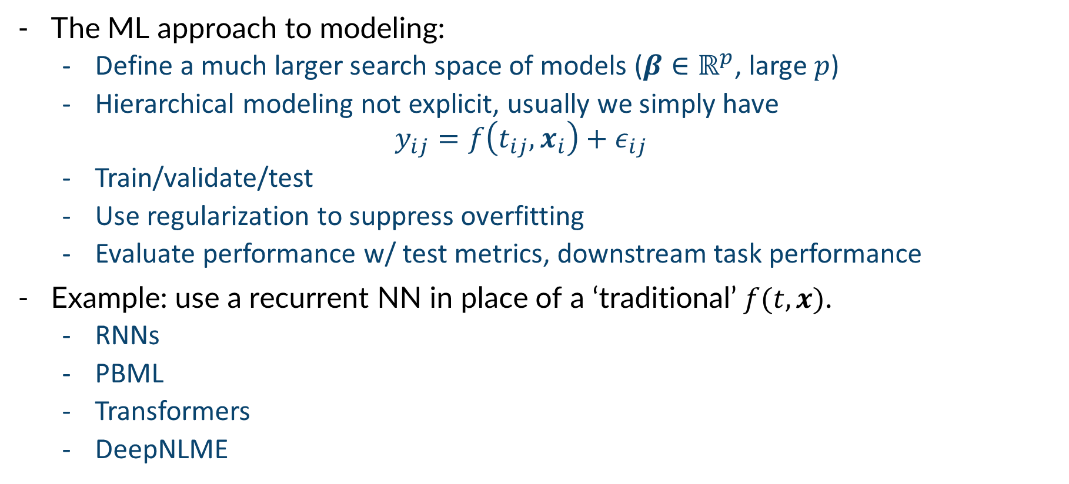
AI/ML Approaches
The ML approach to modeling:
Define a much larger search space of models ($β∈ℝ^{p}$, large $p$)
Hierarchical modeling not explicit, usually we simply have
$$y_{ij}=f\left(t_{ij},x_{i}\right)+ε_{ij}$$
Train/validate/test
Use regularization to suppress overfitting
Evaluate performance w/ test metrics, downstream task performance
Example: use a recurrent NN in place of a ‘traditional’ $f(t,x)$.
RNNs
PBML
Transformers
DeepNLME

Slide 19
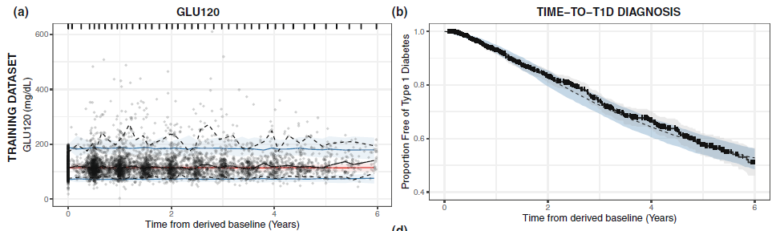
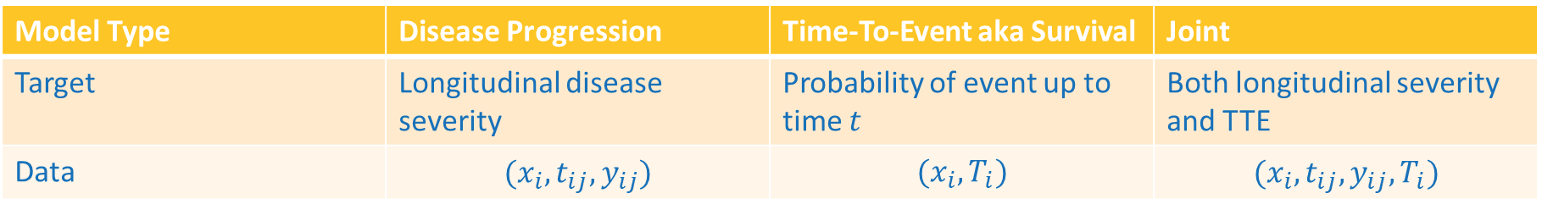
Common Types of Disease Models
Model Type | Disease Progression | Time-To-Event aka Survival | Joint
Target | Longitudinal disease severity | Probability of event up to time $t$ | Both longitudinal severity and TTE
Data | $$(x_{i},t_{ij},y_{ij})$$ | $$(x_{i},T_{i})$$ | $$(x_{i},t_{ij},y_{ij},T_{i})$$
Purpose: Predict, cluster, stratify, design

Slide 20
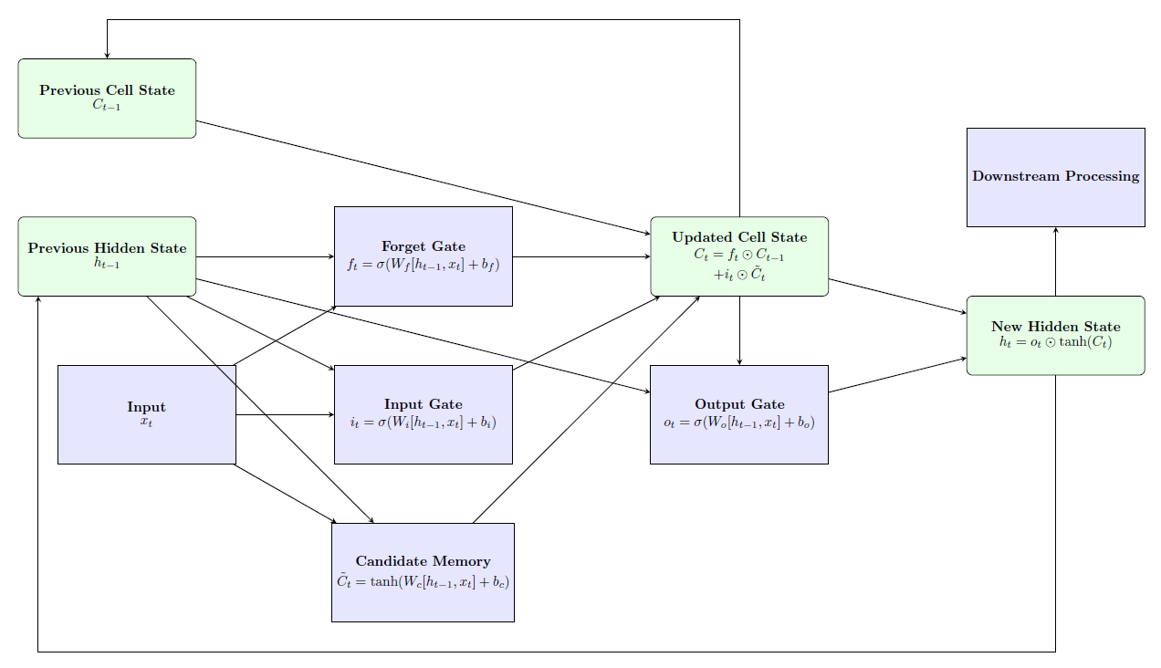
LSTM Block

Slide 21
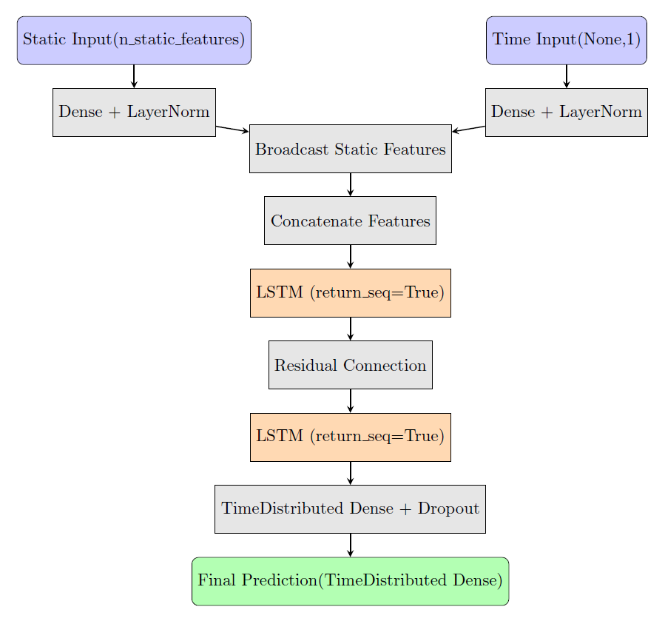
LSTM Model Architecture
Subject covariates -> static features
Time input -> pad & stack times

Slide 22
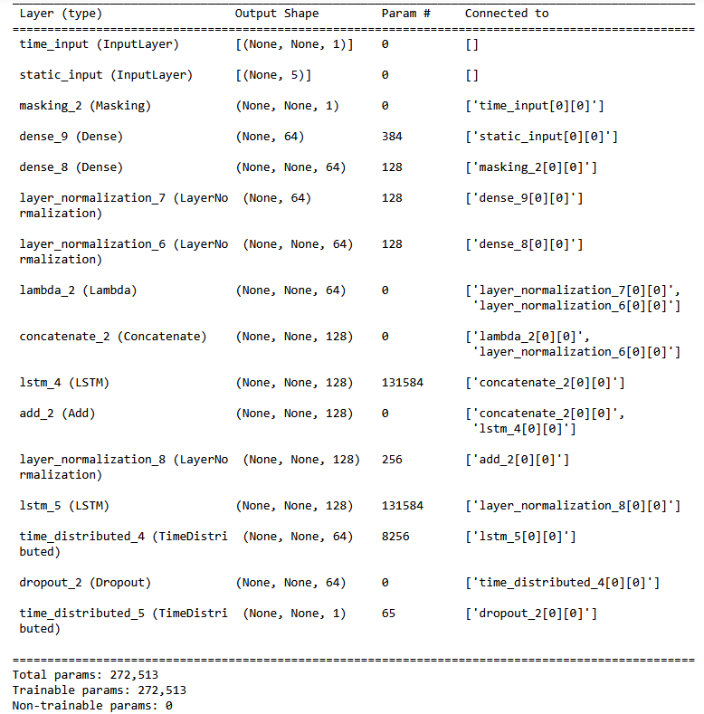


LSTM Model Architecture
Subject-specific times $t_{ij}$
Subject covariates $x_{i}$
Handling var. seq. padding
Encoding times & covariates
Normalization
Broadcast & cat features
Primary LSTM -> temporal dependency
Residual connection
Normalization
Second LSTM -> “deep features”
Output MLP to post-process LSTM output

Slide 23
Compare & Contrast Discussion
What are the salient features of an NLME model that make it appealing?
Interpretable/derivable general model “subjects get worse at first then plateau”
Heterogeneity is directly quantified via ME model
Dependence on covariates is “via hierarchy” -> interpretable effects
What are the salient features of an ML model that make it appealing?
Maximum predictive performance, possibly (arch search!)
Wide architectural choices -> novel data types
Efficiency for large, complex data
Dependence on covariates is explicit
Novel tasks: clustering, classification, digital twins (genAI), “model query”

Slide 24
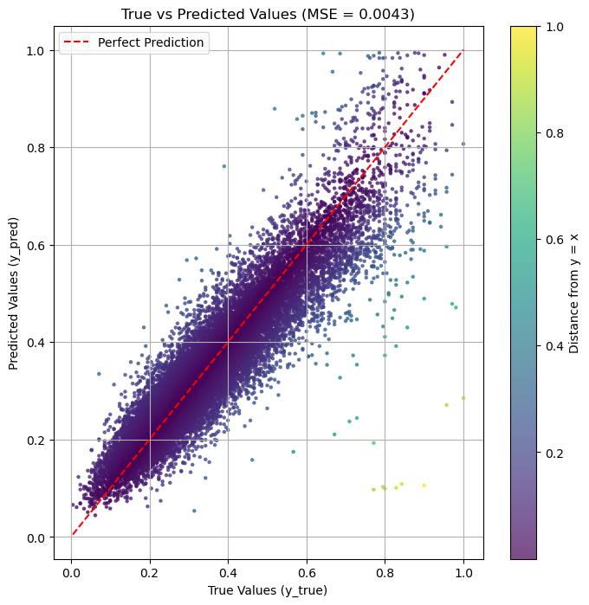
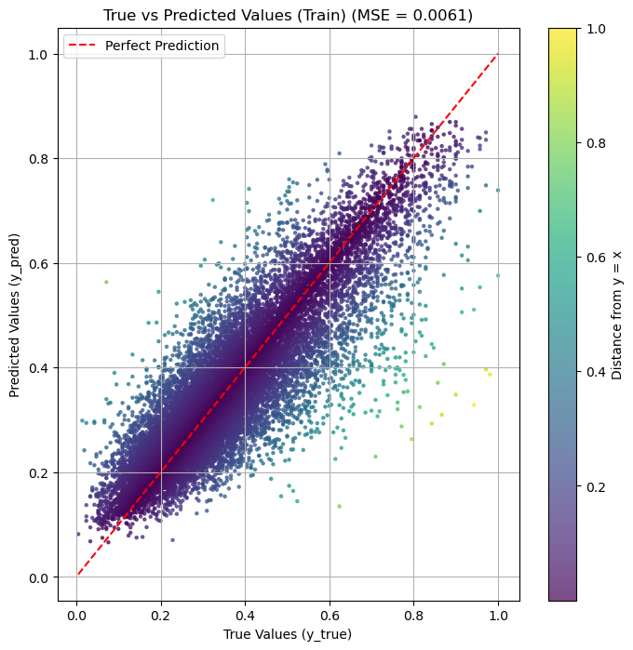
Some Results
NLME MAP Estimator
LSTM Model

Slide 25
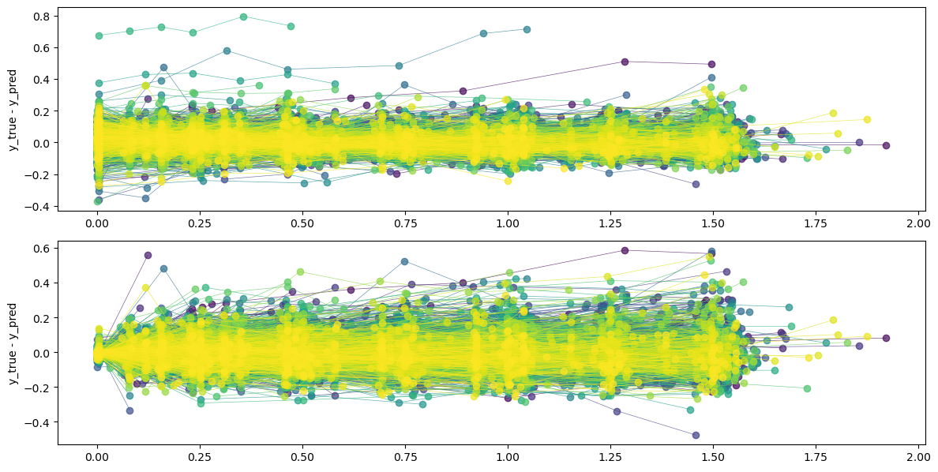
Individual Prediction Residuals

Slide 26
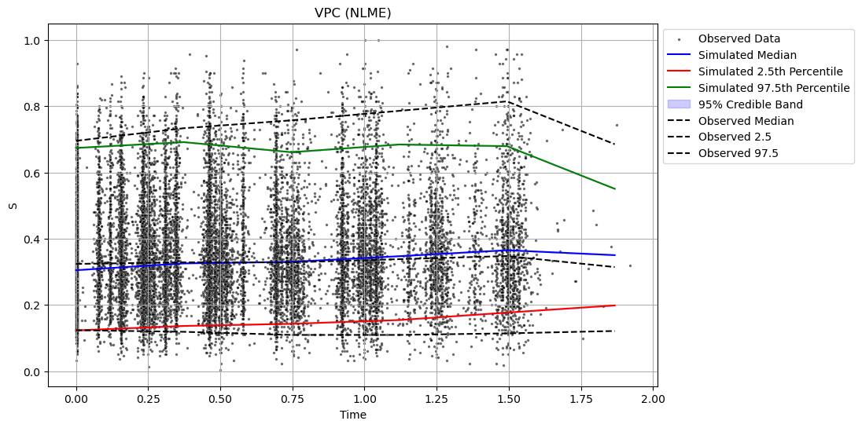
Visual Predictive Check Plots

Slide 27
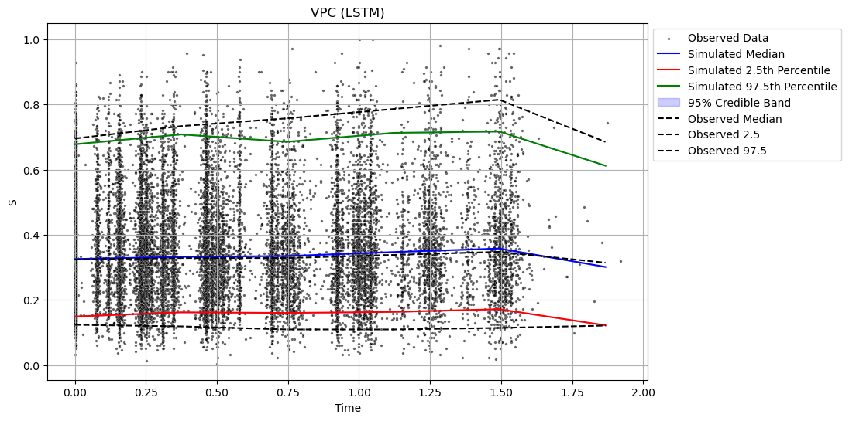
Visual Predictive Check Plots

Slide 28
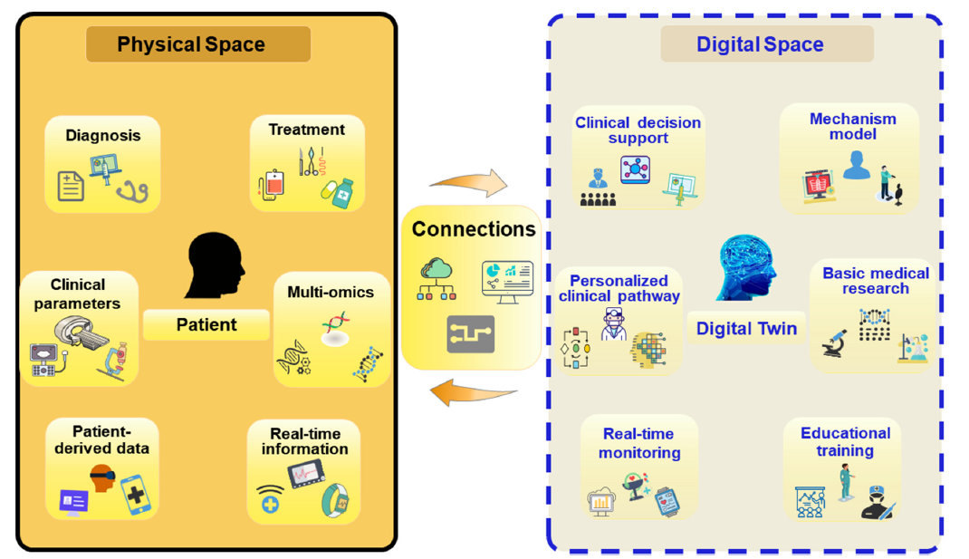
Digital Twins in Medicine
Sun et al 2023 “Digital twin in healthcare: update and challenges”

Slide 29
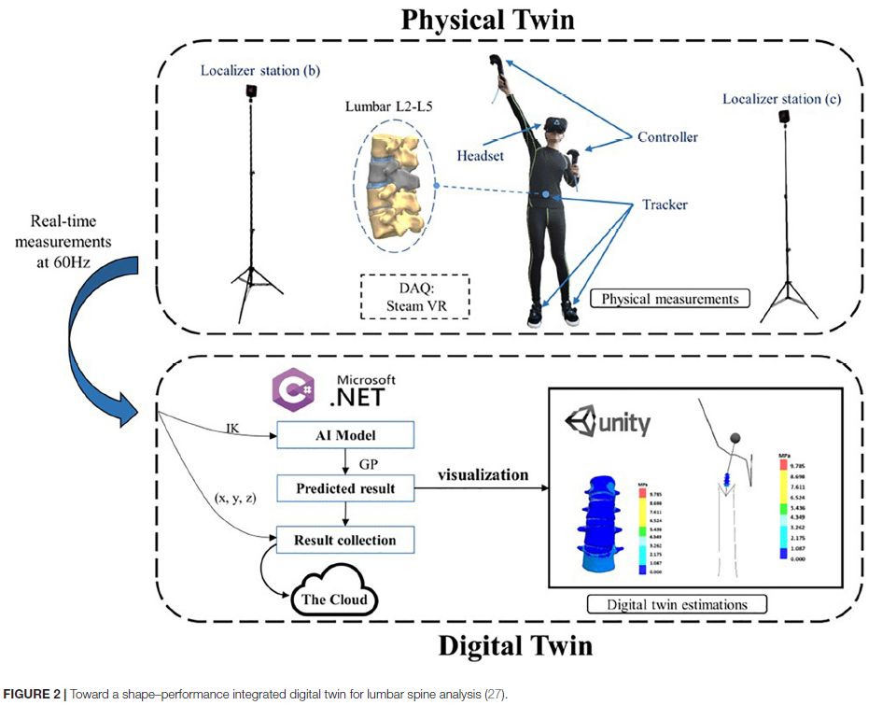

Specific use cases

